Slide 1




#23NTCCommsDevTeams
#23NTC
Communications and Development Teams
Working Better Together

Slide 2
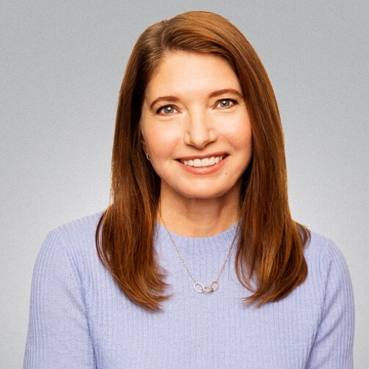
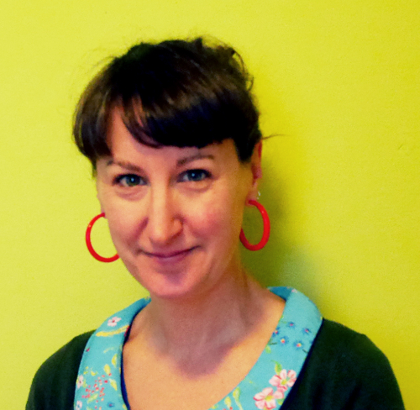
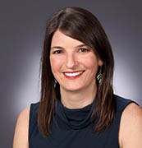
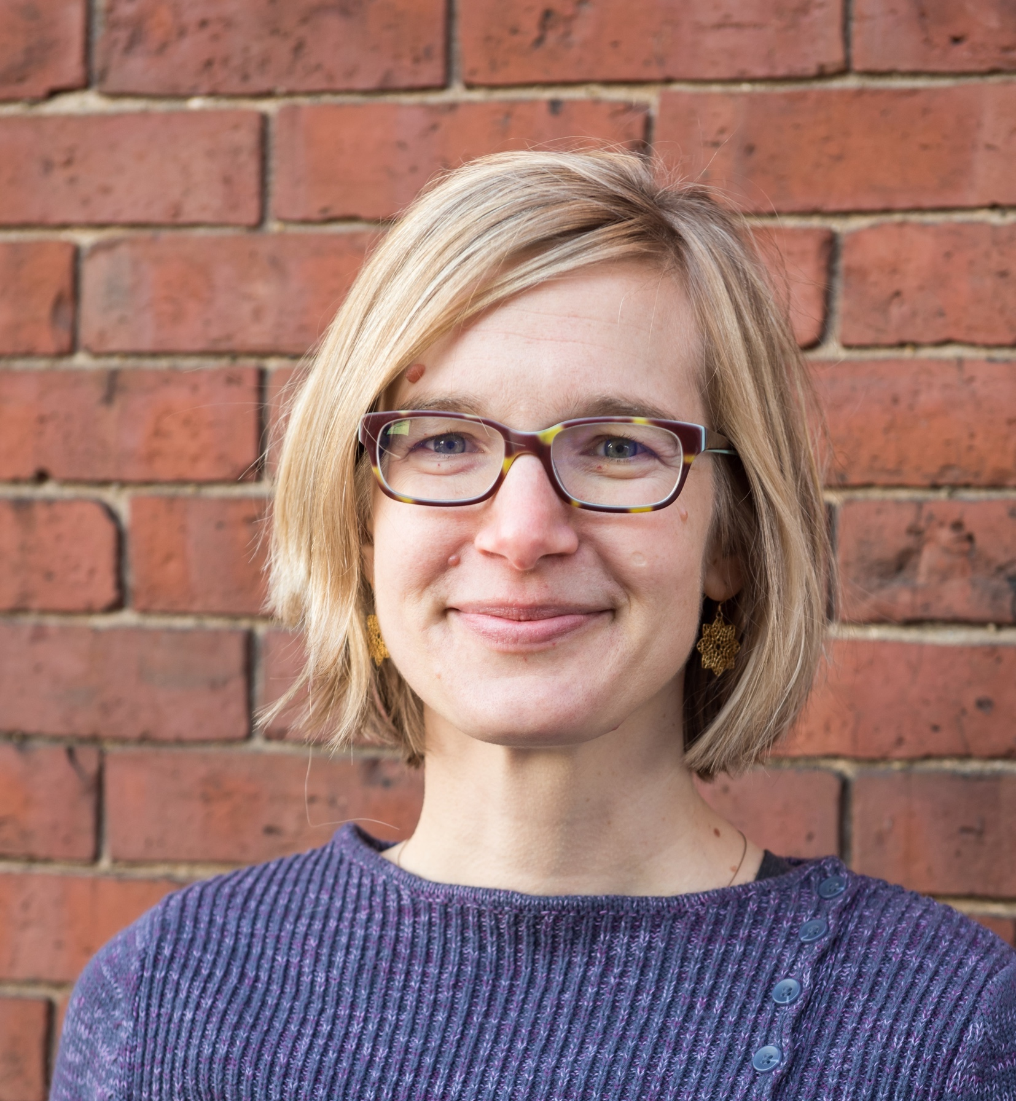
Your Friendly Panelists
Alice Hendricks
(She/Her)
Cause Craft
Consulting
Karla
Capers
(She/Her)
Oxfam America
Julia
Toepfer
(She/Her)
National Immigrant Justice Center
Misty
McLaughlin
(She/Her)
Cause Craft
Consulting

Slide 3
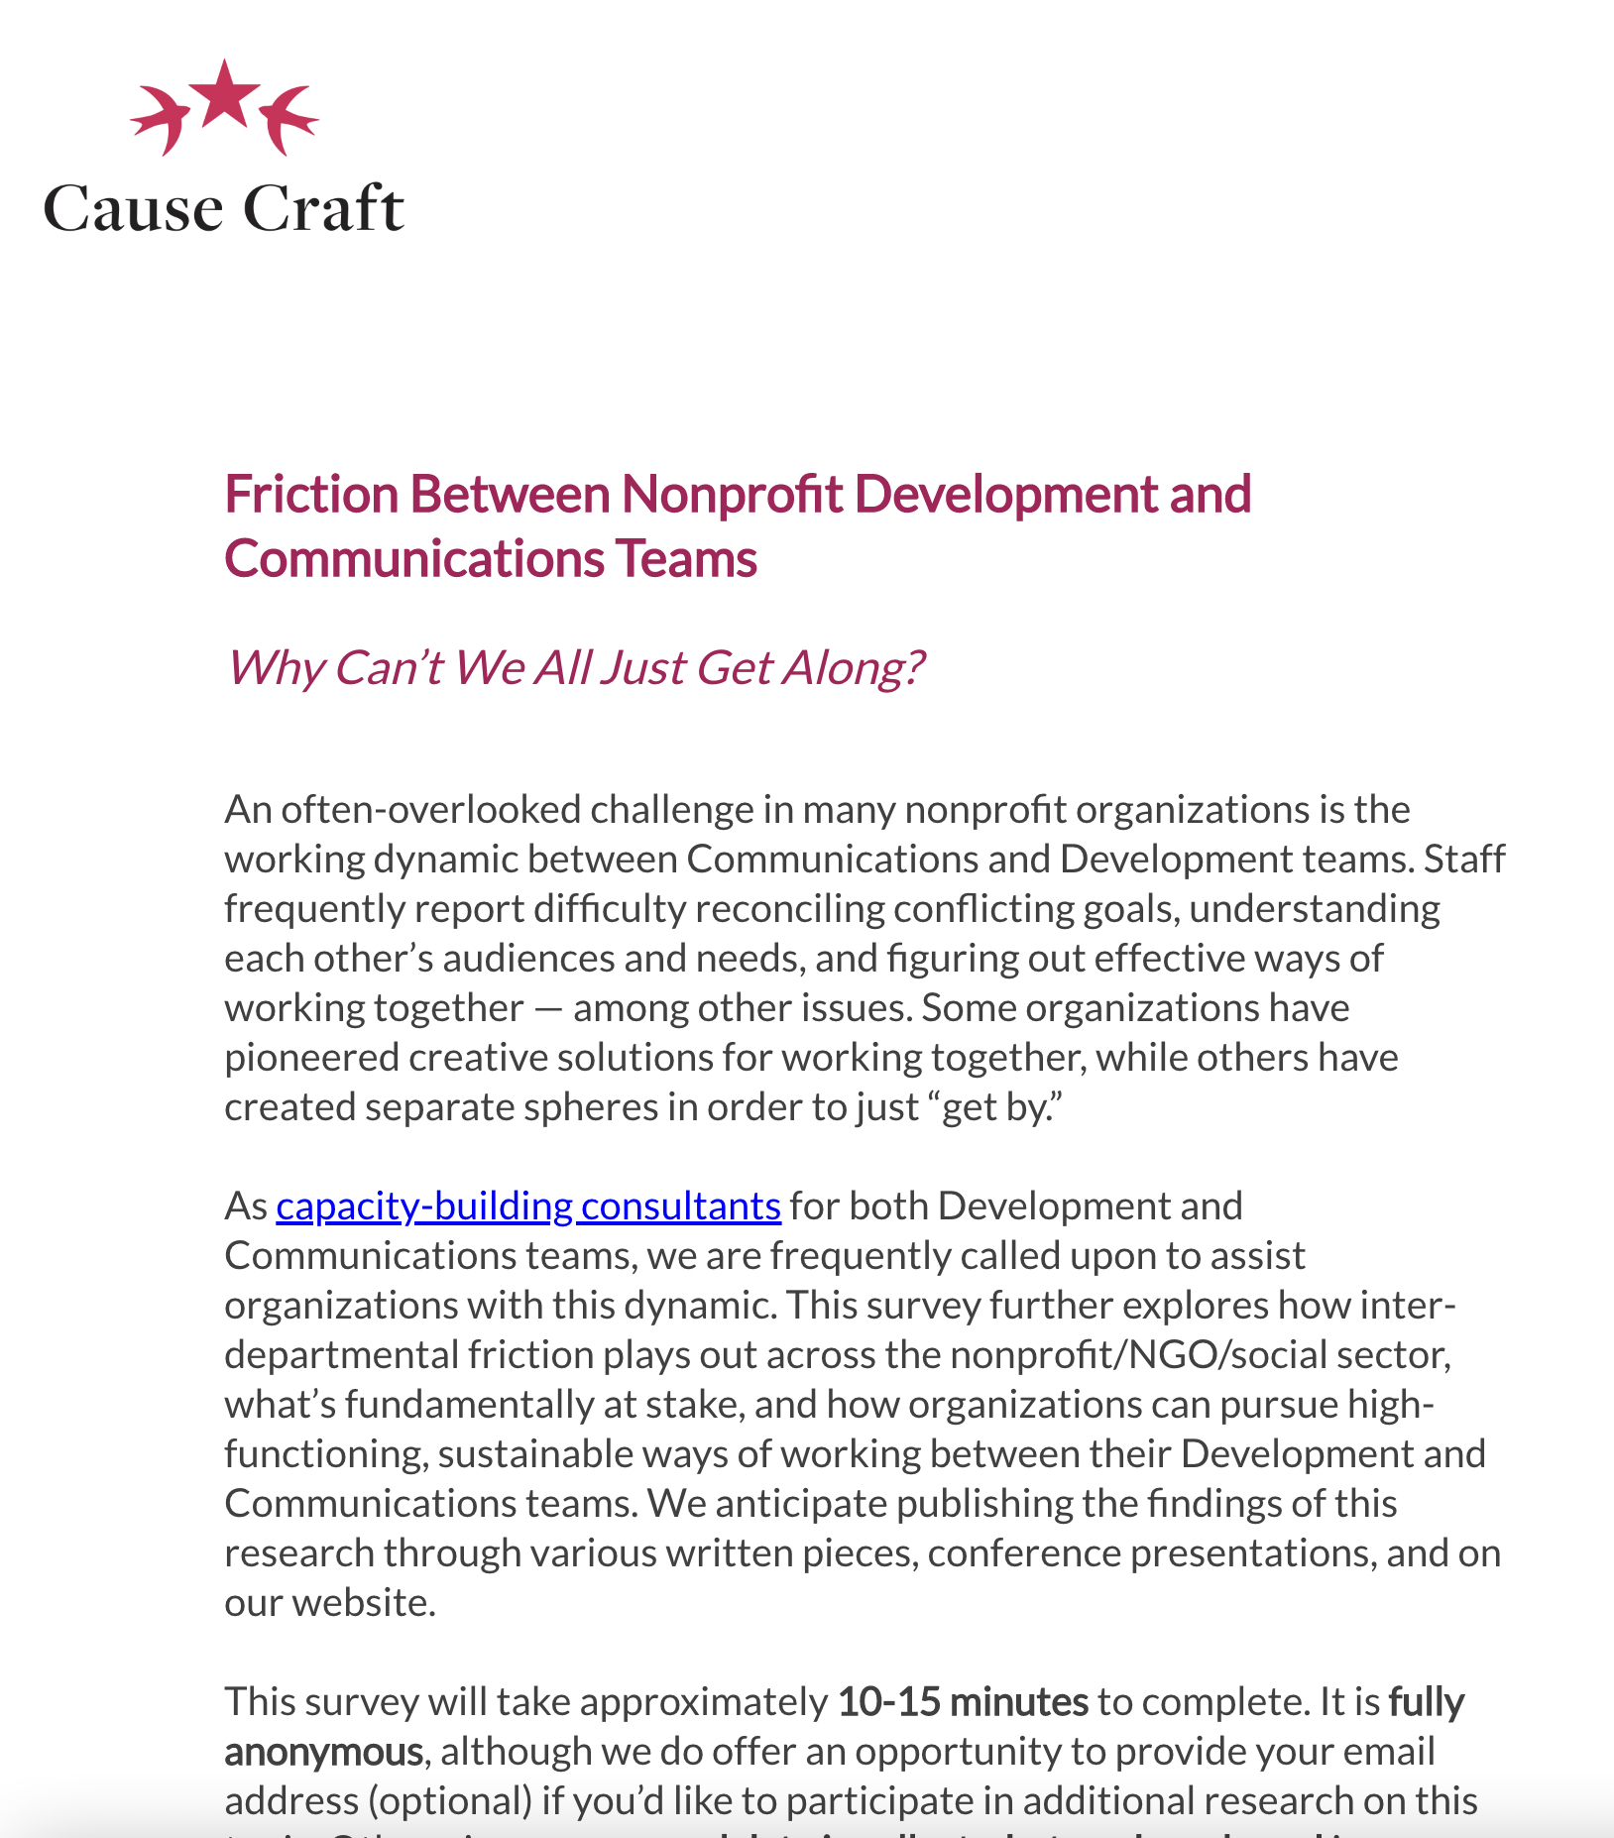
Research
We asked nonprofit staff to weigh in on:
What works and what doesn’t
How process & governance helps them (or doesn’t)
Creative solutions to effective collaboration
84 Reponses

Slide 4
Survey Participants
Mix of Org Types
Arts & Culture
Disaster/Int’l Relief Environmental
Health
Education, Hunger/Poverty
Public Media Organizing
Religious
Rights
Social Services Wildlife/Animal Welfare
Consultants

Slide 5
Survey Participants

Slide 6
Survey Participants

Slide 7
What Do These Teams Have in Common?
Commitment to engaging external audiences
Responsibility for messaging and message delivery
Oriented towards results and outcomes: donations, likes, shares, mentions, placements, sign ups
Mix of one-to-one (e.g. high touch) and one-to-many (e.g. mass market) approaches

Slide 8
Key Differences Between Org Types
Organizations differ the most based on:
Org Size: Smaller orgs tend to have less conflict.
Mission & Orientation: Fundamental differences between think tanks (where content is queen) vs movement orgs (where fundraising and advocacy reign) vs foundations vs service providers vs higher ed
Structure: There tends to be less friction when Comms+Dev are one team vs distinct teams.
Digital Model: When digital is both centralized and distributed (hybrid structure), it can act as an ambassador between functions.

Slide 9

Success of marketing/comms and fundraising are not mutually exclusive. When true collaboration and alignment between these efforts takes place, the results are scalable, significant and a win-win for all.

Slide 10
Key Takeaways: Effectiveness
Ineffective
Somewhat Ineffective
Neutral
Somewhat Effective
Effective
Inter-team collaboration
Messaging, brand & voice guidelines
Shared strategies & goals
Processes & decision rights
Role & responsibility clarity
Giving & receiving feedback
Articulating priorities & planning approaches
Clarity of audience ownership
Overall effectiveness of working dynamic

Slide 11
Q
What are the core tensions you’ve seen and experienced in your organizations?

Slide 12
Where Do the Tensions Often Lie?
Deadlines: speed to market
Voice/tone/messaging approach: urgency vs nuance
Decision rights: the final say
Data: more metrics- vs gut-driven
Programs knowledge: who has stronger ties to that knowledge?
Channel control: who is the gatekeeper?
Content access: first rights to stories, images, videos
Audience ownership: who owns the list?
Attribution: who gets credit?
Tech: whose business practices take precedent?
Rapid response: who drives it?

Slide 13
Inter-Team Divisions: The Eternal Story
Differences in team-specific cultures
Lack of shared strategy/mandate
Misunderstanding each other’s expertise
Unrealistic audience-engagement goals
Missing technology/tools
Territoriality
Lack of trust
Too many giving input
Too many deciders
Conflict becomes highly personalized
Navigating distributed/remote/hybrid environments

Slide 14

Communications often approaches things from ‘what we need to say’ and Development approaches things from ‘what our supporters want to hear.’
Which department is allowed to grow and under what conditions seems to be a perpetual tension.
There’s a culture of competition rather than collaboration between the two teams.

Slide 15
Communications to Development
“All you care about is money money money.”
Development to Communications
“The only audience you care about is media and press hits.”

Slide 16
Key Takeaway | How best to get work done together?
“The 1:1 thing is a bandaid. I’m desperately dumping my personal political capital like a bucket onto a house fire. It's not a long term solution.”

Slide 17
Key Takeaway | Workflows & Governance
“My teams have relatively strong documented processes that account for team expectations, but execution and qualitative collaboration is still lacking.
You can have the best processes and documentation, but things like teamwork and psychological trust/safety amount cross team members can be a separate issue.”

Slide 18
Q
What creative solutions have you found for building trust and improving the working dynamic between departments?

Slide 19
The best improvements have come more so in the qualitative trust building among team members.
This is where leadership must set the priority to support a culture of trust and collaboration, not just among their teams, but among leadership as well.

Slide 20
Solutions: The Laundry List
Hard Tools
Collaboration Roadmap, joint Comms-Dev Charter
Shared planning process & KPIs
Comprehensive calendar
Message hierarchies
Clear policies between departments, including processes with decision rights
Centralized documentation
Shared content assets
A shared integration and project management team
Working with outside strategy & planning firms as neutral, expert 3rd parties
Soft Tools
Take it off of email, to phone or web conference
Mutual visibility into audiences
Daily huddles
Recognize that Comms and Dev are 2 distinct skillsets, need 2 diff profiles
No one in a straight “service provider” role
Senior alignment (in addition to ICs)
Sharing results, especially using data to demonstrate what works
Dev-Comms “mini retreats” 2x/year
Sense of joint ownership and collaboration

Slide 21
Solution:
Project Charters / Terms of Reference
Download the Project Charter / Terms of Reference template

Slide 22
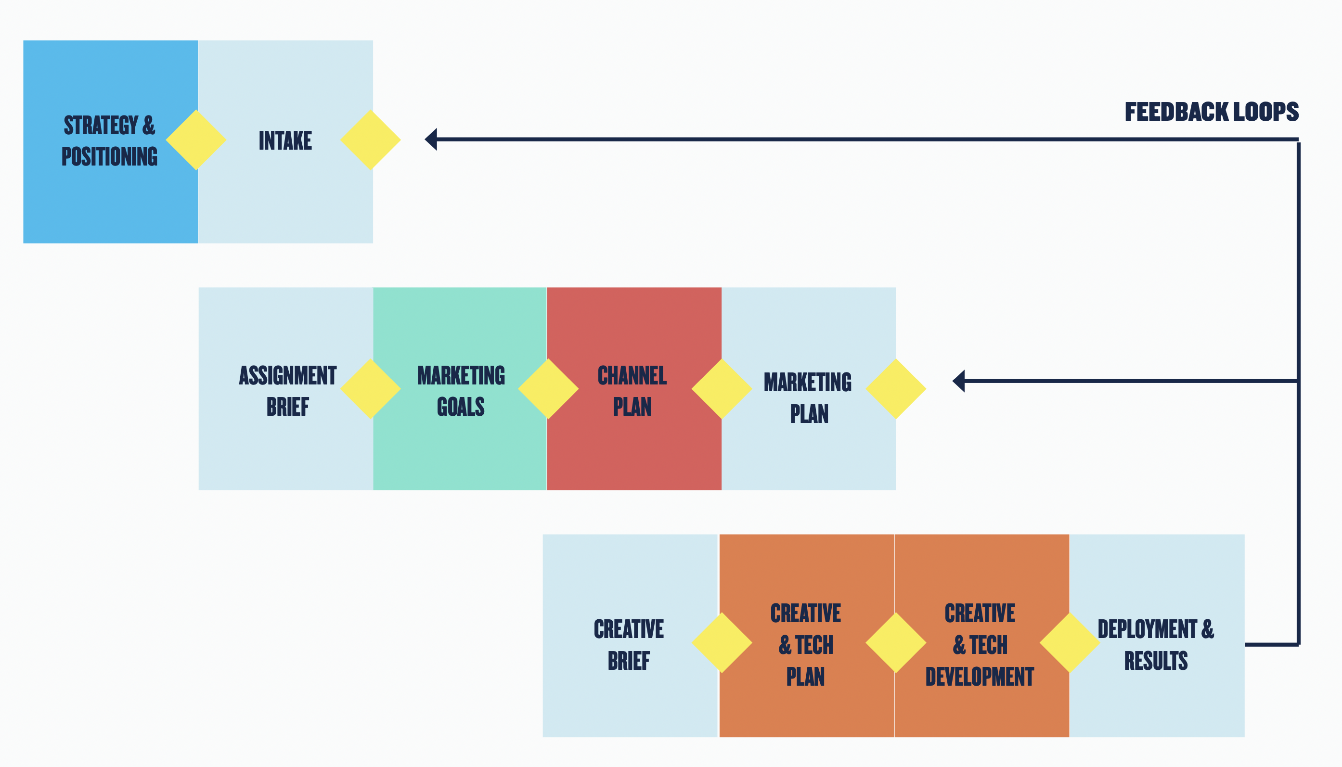
Solution:
Clear, Documented Process & Intersection

Slide 23
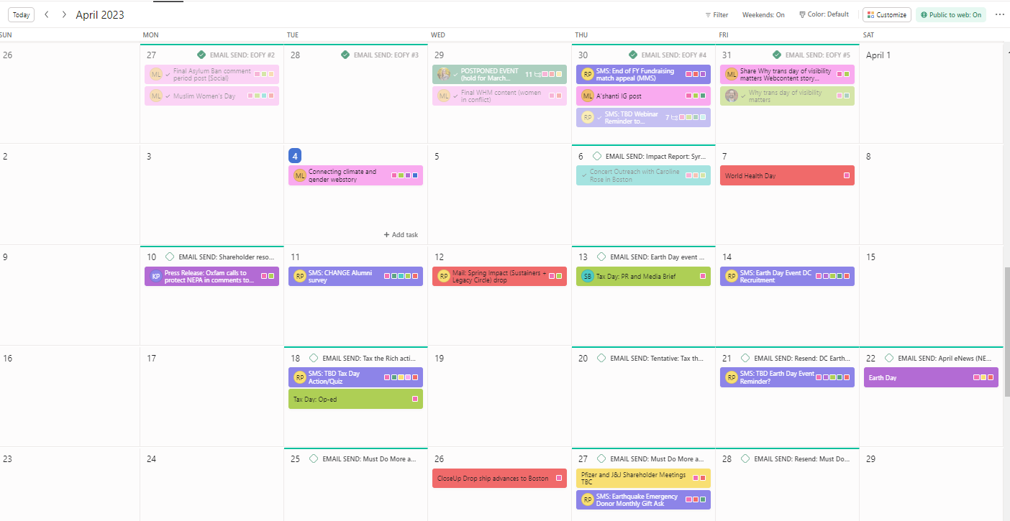
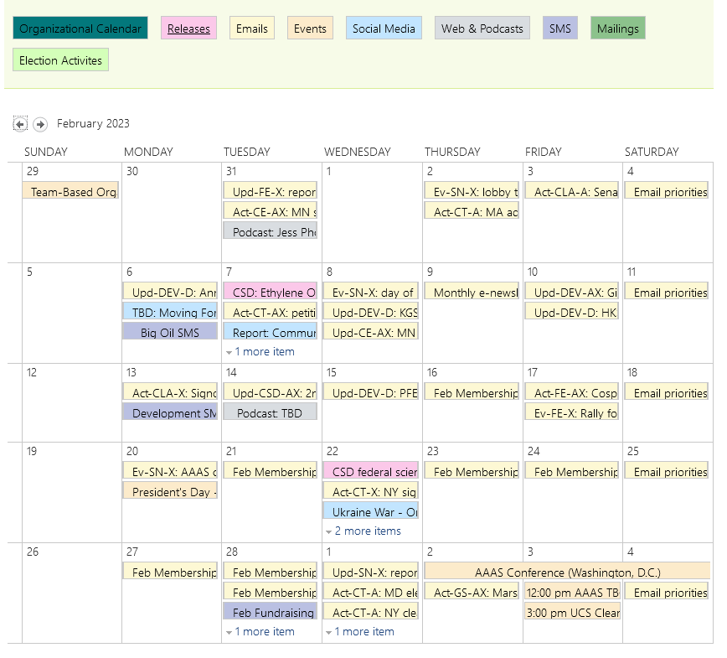
Solution:
Shared Calendars

Slide 24
Q
What does a more constructive working dynamic
look like?
(hint: recognizing expertise, partnering/supporting versus servicing or policing)

Slide 25
We need organization-wide recognition that Development and MarComms are equally strategic and important in the continued success of the organization.
We must help the fundraising folks at this org understand that they cannot bring in the money without the support of communications, and communications aren’t support staff for departments so much as a fundamental component of driving member/donor engagement to achieve broader organizational goals.

Slide 26
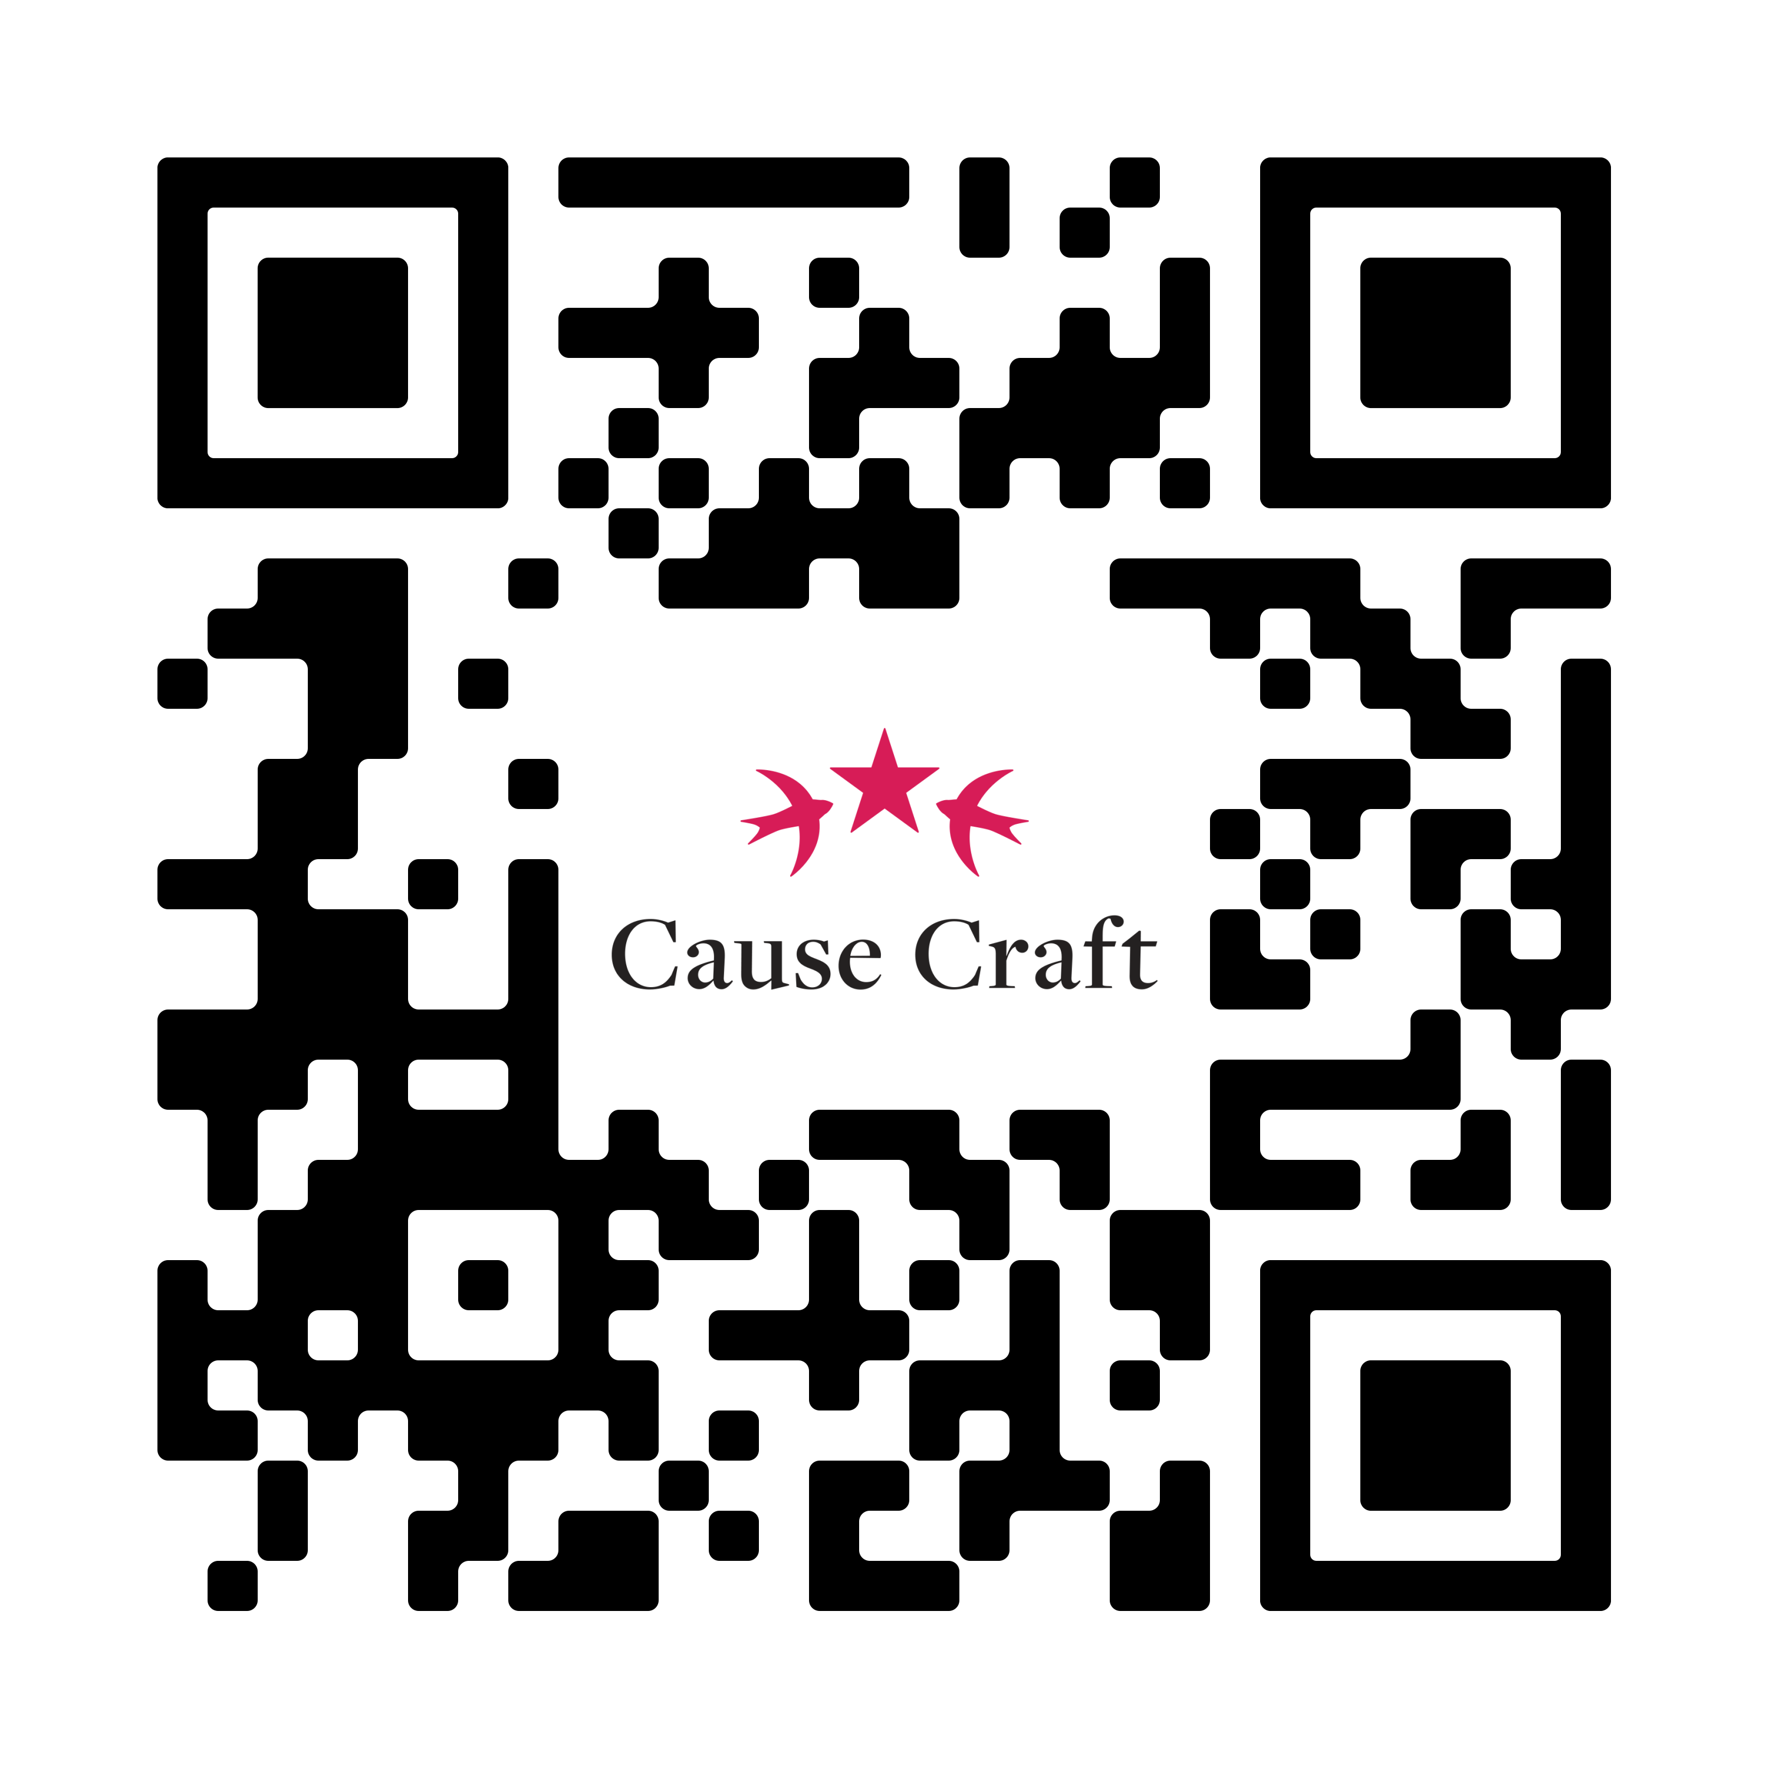
And Your Questions?
Take the Comms Dev Survey
www.causecraftconsulting.com/comms-dev-survey
Follow us on LinkedIn for more research results
https://www.linkedin.com/company/cause-craft-consulting/

Slide 27
Thank You!
Please take our session survey.
Karla
Capers
(She/Her)
Julia
Toepfer
(She/Her)
Misty McLaughlin
(She/Her)
Alice Hendricks
(She/Her)

